Slide 1
Medieval Period

Slide 2
Introduction
What comes to mind when you hear the word “Medieval?”
Feudalism
Crusades
Black Death

Slide 3
Feudalism
What is feudalism?
System of governing and landholding based on land for loyalty
Loyalty Land grants
Hierarchical social structure

Slide 4
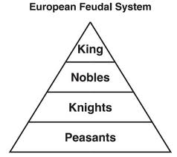
Feudalism
King: Consolidated power by providing land in exchange for loyalty
Nobles: Wealthy landowners who pledged their loyalty to the king
Knights: Warriors who pledged to defend their lords’ lands for land
Peasants: Vast majority of people who worked the field. Serfs tied to the field

Slide 5
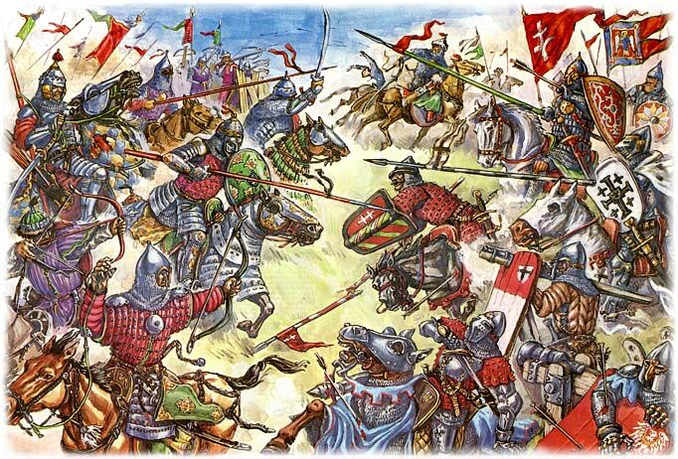
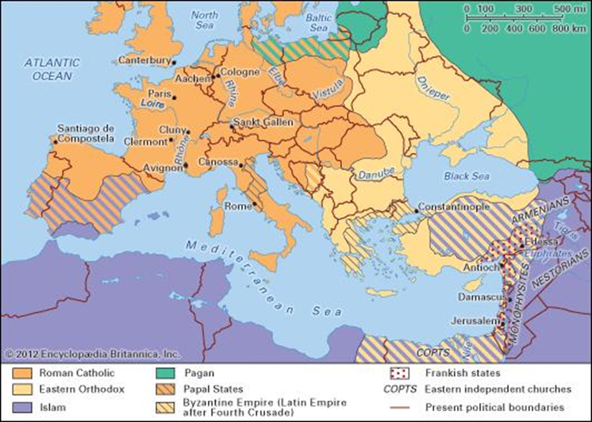
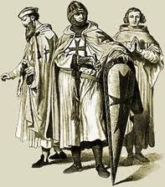
The Crusades (36:30)
Religious military expeditions
1095 – 1291
Christians vs. Muslims
Christian objectives:
Stop the spread of Islam
Retake Holy Land
Conquer infidel territory

Slide 6
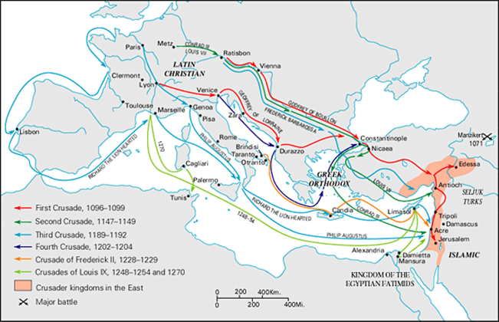
The Crusades
Crusaders fighting for atonement of their sins
Controversial chapter in the history of Christianity

Slide 7
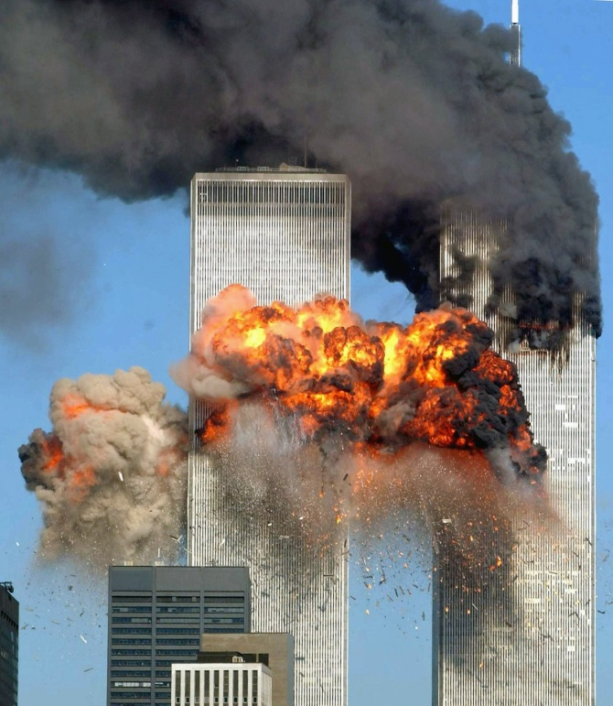
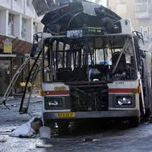
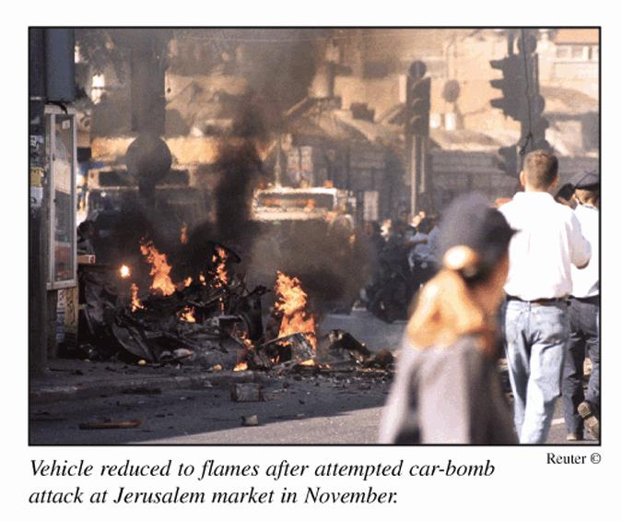
The Crusades
Have the crusades ended?

Slide 8
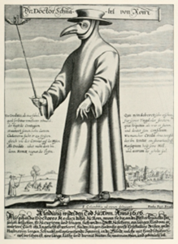
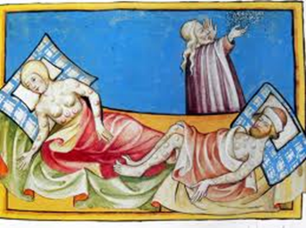
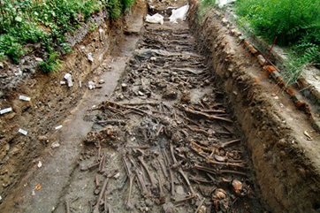
The Black Death (12:45)
Ravaged Europe between 1347 – 1351
Chinese origins Mediterranean Seaports Mainland Europe
Killed 1/3 of Europe’s population.
25 million people

Slide 9
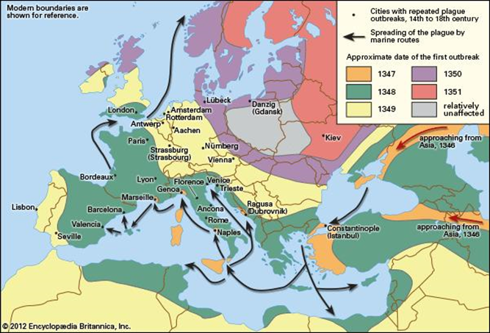
The Black Death
17,123 deaths/day
713 deaths/hour
11 deaths/minute
Depopulation and total disappearance of 1000 villages
Took 200 years to restore European population to 14th century figures

Slide 10
The black death
Think the bubonic plague is a thing of the past? Think again.

